Slide 1

Using the Set Operators

Slide 2
Describe the Set Operators
Set Operators
UNION - All distinct rows selected by either query
UNION ALL - All rows selected by either query, including all duplicates
INTERSECT - All distinct rows selected by both queries
MINUS - All distinct rows selected by the first query but not the second

Slide 3
Using the Set Operators
Set operators are used to join the results of two (or more) SELECT statements.
The UNION set operator returns the combined results of the two SELECT statements. It removes duplicates from the results i.e. only one row will be listed for each duplicated result.
The UNION ALL set operator which retains the duplicates in the final result.
INTERSECT lists only records that are common to both the SELECT queries
The MINUS set operator removes the second query's results from the output if they are also found in the first query's results.
INTERSECT and MINUS set operations produce unduplicated results.

Slide 4
Using the Set Operators
Same number of columns must be selected by all participating SELECT statements.
Column names used in the display are taken from the first query.
Data types of the column list must be compatible/implicitly convertible.
Positional ordering must be used to sort the result set. ORDER BY can appear once at the end of the query. For example,
UNION and INTERSECT operators are commutative, i.e. the order of queries is not important; it doesn't change the final result.
Performance wise, UNION ALL shows better performance as compared to UNION because resources are not wasted in filtering duplicates and sorting the result set.
Set operators can be the part of sub queries.

Slide 5
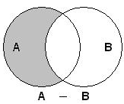
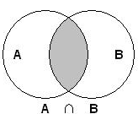
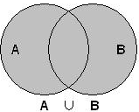
Relationship to Mathematical Set Theory
Correlation between the set operator, the mathematical notation and a Venn diagram representing the relationship.
MINUS operation is analogous to a difference
INTERSECT named the same as the mathematical operation
UNION is also named the same as the mathematical operation
UNION ALL does not have an analogous operation in elementary set theory where there is no notion of duplicates.

Slide 6
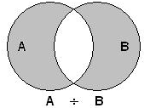
Relationship to Mathematical Set Theory
Other mathematical operations can be emulated by combining SQL operations.
For instance, creating a symmetric difference can be accomplished by the following combination:
(<query 1> UNION <query 2>)
MINUS
(<query 1> INTERSECT <query 2>)

Slide 7
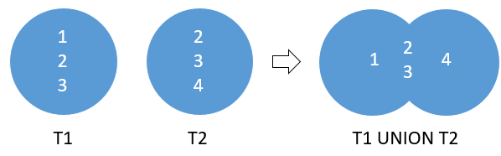
Using the Set Operators - The UNION operator
SQL Code
SELECT column_list_1
FROM T1
UNION
SELECT column_list_1
FROM T2
The column_list_1 and column_list_2 must have the same number of columns presented in the same order.
The data type of the corresponding column must be in the same data type group such as number or character.
By default, the UNION operator returns the unique rows from both result sets.

Slide 8
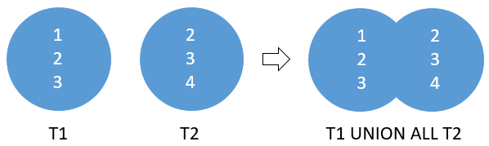
Using the Set Operators - The UNION All operator
SQL Code
SELECT column_list
FROM T1
UNION ALL
SELECT column_list
FROM T2
If you want to retain the duplicate rows, you explicitly use UNION ALL

Slide 9
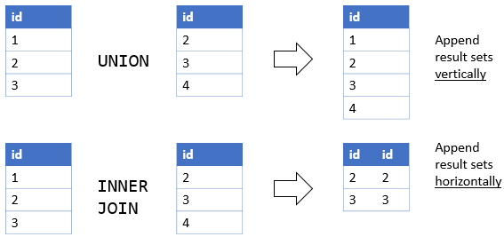
Using the Set Operators - UNION vs. JOIN
A UNION places a result set on top another, meaning that it appends result sets vertically.
However, a join such as INNER JOIN or LEFT JOIN combines result sets horizontally.

Slide 10
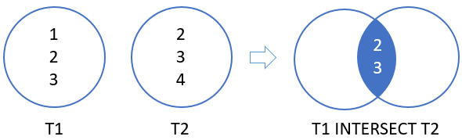
Using the Set Operators - The Intersect operator
SQL Code
SELECT column_list_1
FROM T1
INTERSECT
SELECT column_list_2
FROM T2
The number and the order of columns must be the same in the two queries.
The data type of the corresponding columns must be in the same data type group such as numeric or character.

Slide 11
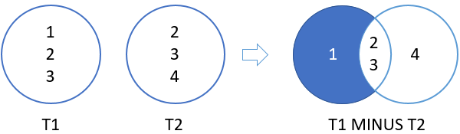
Using the Set Operators - The Minus operator
SQL Code
SELECT column_list_1
FROM T1
MINUS
SELECT column_list_2
FROM T2
The number of columns and their orders must match.
The data type of the corresponding columns must be in the same data type group such as numeric or character.
MINUS Returns only the rows in the first result set that do not appear in the second result set, sorting them and removing duplicates.

Slide 12
Using the Set Operators
Questions

